Slide 1
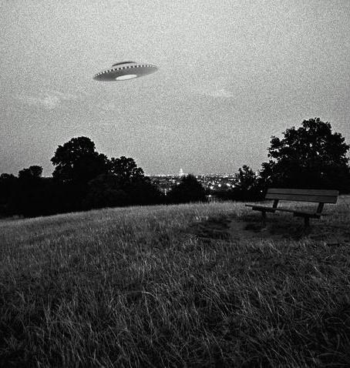
UFO Hacker
Joseph Kaufman

Slide 2

NASA, Navy, Army, and Pentagon Security Issues
From the late 90s to early 2000s known to Run Windows (and probably still do)
Vulnerabilities:
Windows Office Protocol (Phishing) and NetBIOS (IP Scanning)
Weak or lack of passwords on computers
Human engineering issues
General lack of security

Slide 3

McKinnon Background
UK High School dropout and self-taught computer systems administrator
Had an obsession with UFOs
Hacked into various US government institutions from February 2001 to March 2002
Later diagnosed with Autism

Slide 4

Technically what happened?
February of 2001 hacks begin until 2002
NetBIOS allows McKinnon to access government computers from UK
Windows Office Protocol allows McKinnon to run Pearl scripts to scan for passwords
Weak passwords
McKinnon is in!

Slide 5

Once In
McKinnon downloads virtual access software RemotelyAnyhwere
Enabled deleting and transferring files
Searches NASA, Navy, Army, and Pentagon for UFOs
Worker discovers him
Talks his way out
McKinnon downloads various images of UFOs and confidential documents

Slide 6

McKinnnon Caught
March 2002
McKinnon left multiple messages on government websites and RemotelyAnywhere led to his discovery
US seeks to extradite him because…

Slide 7
What damage did it cause?
Damages to Naval Air Station and Earle Naval Weapons Station after 9/11 causing 300 computers to crash
Suspected of causing $800,000 in damages
Resulted in a lack of trust in US government security systems
Unknown damages to operations of military

Slide 8
How could it be prevented?
Stronger firewalls
Prevent installation of suspicious software
Security against Windows NetBIOS and Office Protocol
Very limited access or no access for remote users
Increased cybersecurity funding
Education against human engineering
Stronger passwords for users

Slide 9
Sources
https://www.bbc.com/news/uk-19946902
https://www.sciencedirect.com/topics/computer-science/vulnerability-window
https://beyondsecurity.com/scan-pentest-network-vulnerabilities-windows-host-netbios-information-retrieval.html
https://www.blackhatethicalhacking.com/articles/free-access/hacking-stories-gary-mckinnon-and-the-biggest-military-computer-hack-of-all-time/

